Slide 1

SyriaTel Churn Prediction.
PHASE_3_CAPSTONE

Slide 2
Customer Churn Prediction & Analysis.
This project aims to predict whether a telecommunications customer is at risk of soon stopping business with the company. Using machine learning classifiers, we identify customers likely to churn and provide actionable insights for customer retention.
Key Features
Exploratory Data Analysis (EDA) with visualizations to understand customer behavior.
Feature Engineering: Identifying important predictors of churn.
Machine Learning Models: Five models for classification.
Statistical Analysis: Hypothesis testing and correlation analysis.
Business Insights & Recommendations for Reducing Churn.

Slide 3
Dataset
The data for this project was obtained from Kaggle's : Churn in Telecom's dataset
Columns: Includes usage statistics, customer service calls, and plan details.
Target Variable: soon_churn (1 = high risk of churn, 0 = likely to stay).

Slide 4
Exploratory Data Analysis (EDA) & Visualizations

Slide 5
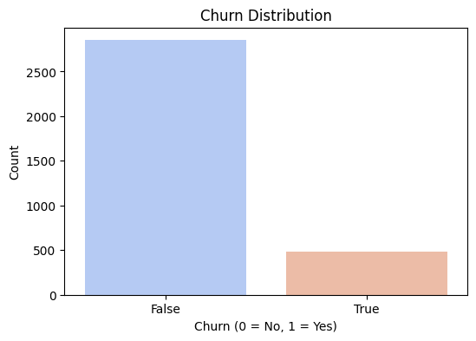
Churn Distribution.
Customers with higher churn need special attention.
Insight :
The dataset has an imbalance (fewer churned customers).
Companies should focus more on churned customers.

Slide 6
Correlation Heatmap
Insights :
Customer service calls have the strongest positive correlation with churn.
Total call minutes and charges are also important factors.

Slide 7
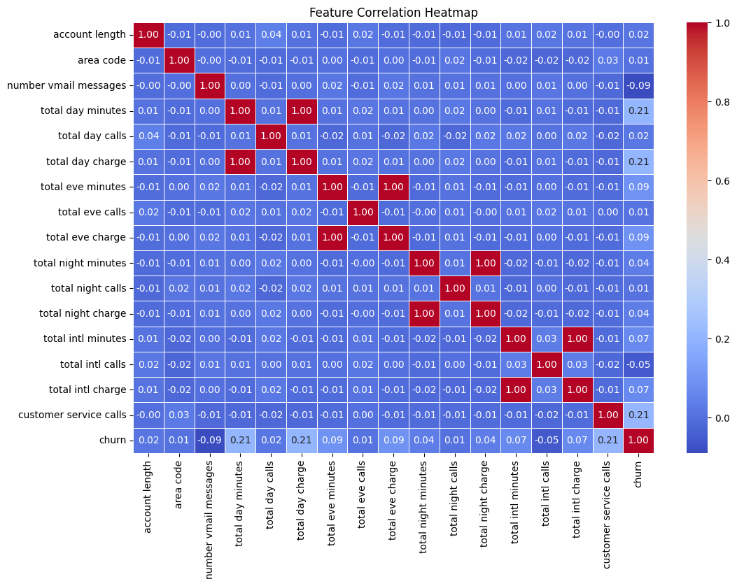

Slide 8
Boxplots: Key Features vs. Churn
Insights :
High total day minutes customers churn more.
More customer service calls indicate dissatisfaction.

Slide 9
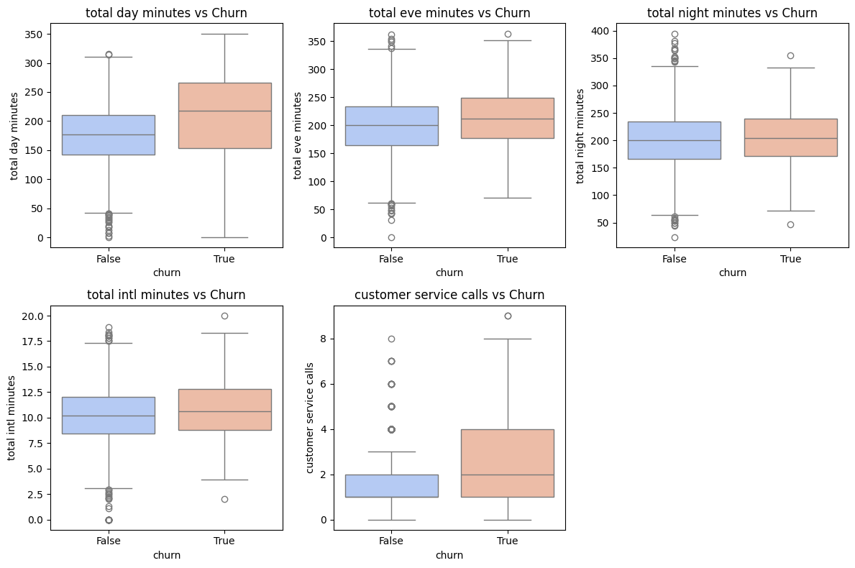

Slide 10
Preprocessing & Feature Engineering
1. Dropped irrelevant columns (e.g., phone number).
2. One-hot encoded categorical features (state, international plan).
3. Created soon_churn as a new target variable.
4. Standardized numerical features for model training.

Slide 11
Machine Learning Models
We trained five classifiers and compared their accuracy.
Model Performance
Best Models: XGBoost & Random Forest (95.95%).

Slide 12
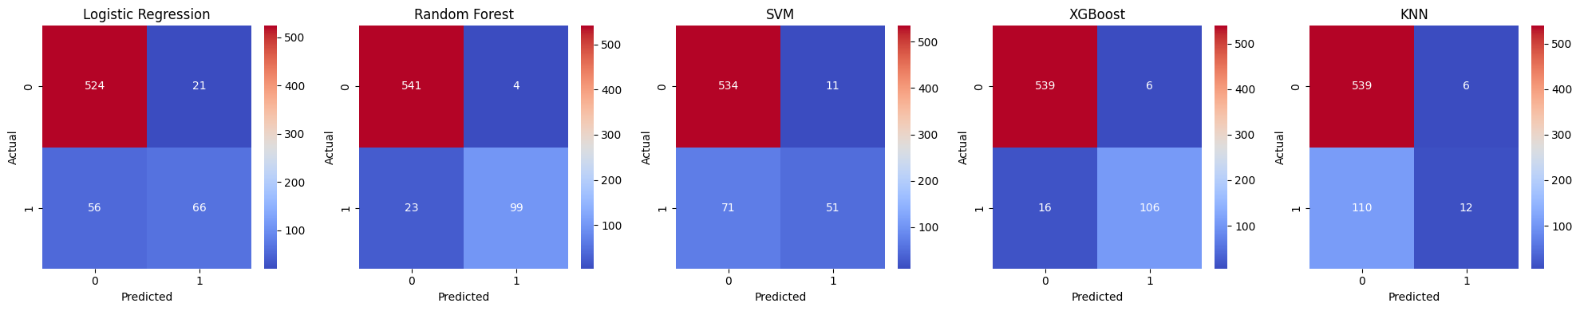

Slide 13
Business Solutions & Recommendations
Proactive Customer Support
Reach out to customers with >3 customer service calls.
Provide better issue resolution & loyalty rewards.
Personalized Retention Offers
Offer special discounts to at-risk customers.
Create flexible data/call plans based on usage.
AI-Powered Chatbots for Customer Assistance
Deploy chatbots to handle common complaints.
Automate responses to prevent churn before it happens.

